Slide 1
What Is It ?
Why Do I Need It ?
How Do I Do It?
Earned Value Analysis

Slide 2

Today’s Situation
Need for accurate and consistent status information
Numerous complex (and interrelated) projects
  Projects with many WBS activities
  Virtual offices
  Diverse technology platforms

Slide 3
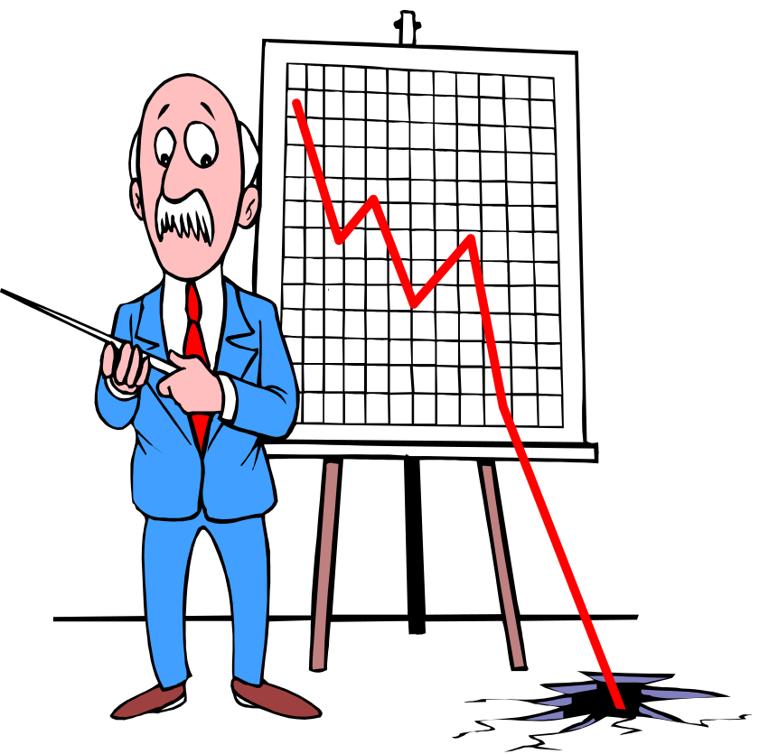
There’s Room For Improvement
70% of projects are:
  Over budget
  Behind schedule
52% of all projects finish at 189% of their initial budget
And some, after huge investments of time and money, are simply never comple
Source:The Standish Group

Slide 4

How to answer the question: “Have we done what we said we’d do?”
% complete estimating % of Budget spent % of work done % of time elapsed
  subjective, incomplete
  draws false conclusions

Slide 5
Enter Earned Value Analysis
“Earned Value Analysis” is:
  an industry standard way to:
    measure a project’s progress,
    forecast its completion date and final cost, and
    provide schedule and budget variances along the way.
By integrating three measurements, it provides consistent, numerical indicators with which you can evaluate and compare projects.
Notes:
(2) Those three measurements are:
time expired
work accomplished
money spent

Slide 6

What’s more Important?
Knowing where you are on schedule?
Knowing where you are on budget?
Knowing where you are on work accomplished?

Slide 7
EVA Integrates All Three
It compares the PLANNED amount of work with what has actually been COMPLETED, to determine if COST , SCHEDULE, and WORK ACCOMPLISHED are progressing as planned.
Work is “Earned” or credited as it is completed.
Notes:
(2) Thus the name Earned Value; you can actually assign a VALUE to the project at a particular time

Slide 8

Earned Value needed because...
Different measures of progress for different types of tasks
Need to “roll up” progress of many tasks into an overall project status
Need for a uniform unit of measure (dollars or work-hours).

Slide 9

Earned Value needed because...
Provides an “Early Warning” signal for prompt corrective action.
  Bad news does not age well.
  Still time to recover
  Timely request for additional funds

Slide 10
And One More Reason
Why You Need EVA
?

Slide 11

Because You Gotta !
These Set the Stage:
GPRA; 1993
FASA, Title V; 1994
Clinger-Cohen Act; 1996
And Then Along Came OMB! (Circular A-11, Part 7)
"Agencies must use a performance based acquisition management system, based on ANSI/EIA Standard 748, to measure achievement of the cost, schedule, and performance goals."
Notes:
GIPRA – (performance measures): clearly define missions, set realistic goals, and report on accomplishments.
FASA – Said you had to meet 90% of your goals (cost, schedule, and performance)
Clinger-Cohen Act - Tried to ensure that IT investments aligned with mission goals and that they are properly justified
(also tried to ensure that systems are secure)
Change to A-11 in July 2002 (A real shot across the bow)

Slide 12

OK, So What Is This Stuff?

Slide 13

So, Is This Stuff New ?
It’s been around since the sixties.
“Cost/Schedule Control Systems Criteria”
(C/SCSC)
Notes:
Was developed by DoD (As are many very specific metrical techniques.
You know, they like for everybody to be:
walking in step
counting cadence together
calling out the same number,
at the same time.
Was in response to a need to keep track of very large and very complex contracts.

Slide 14

Examples of informal Earned Value Analysis
It’s done informally without realizing it.
  30% time used,
  30% $$ spent
  So, if 30% of the work is done, I must be OK ??
Shop floor estimates
Cost comparisons
  Budget vs. Actual

Slide 15
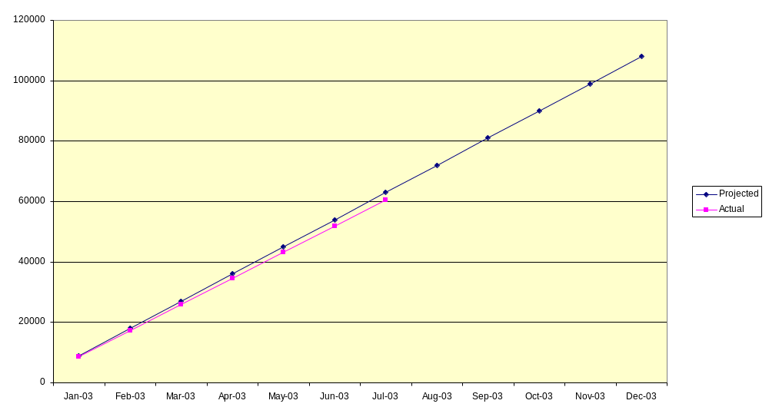
How’s this project doing?
Notes:
We’re looking at a year-long project; Comparing our budget with our expenditures,
Complete through about July, and we don’t appear to be TOO far off track.
BUT, what we don’t know is:
How much WORK have we gotten done?
How tough - in terms of BOTH time and money - will it be to get back on track?

Slide 16

Let’s Take A Look Under The Hood

Slide 17

But First! - We gotta get organized
EVA works best when work is ‘compartmentalized’.
Compartmentalization is best achieved with a well-planned Work Breakdown Structure.
So, how do I create a WBS for a really complex project?
Notes:
The more complex the project, the more difficult it is to tell where you are.

Slide 18

How am I gonna eat this elephant?
Obviously in small bites.

Slide 19
Proper WBS Design
One WBS per program
  Deliverable-oriented
  Work not in the WBS is out-of-scope
  Each descending level represents more detail
Full (and accurate) definition is key
  Defined deliverable(s)
  Timeframe for delivery of product
  Total cost (direct and indirect) to deliver product
  Let’s Look at an example:
Notes:
The WBS should describe
What is to be done
When it is to be completed
How much it will cost

Slide 20

A sample Work Breakdown Structure
Serve Pizzas to Customers
Provide the Place
Cook the Food
Serve Customers
(Others)
Make the Dough
Cook the Sauce
Build the Pizza
Notes:
WBS needs to be broken down into manageable, meaningful pieces.
The danger here is in getting them too small.

Slide 21
WBS Units are “Work Packages”
Lowest level WBS elements
Have an accompanying narrative
Have three measurable components
  Scope of work to be accomplished
  Total (direct and indirect) cost
  Timeframe for completion
Notes:
The Work Package needs to be of the size that it can be handed off to a task manager.
Too large and you have multiple people responsible for the work.
Too small and the program manager winds up micro-managing everything.
The “accompanying narrative” is really an SOW – or Statement of Work.

Slide 22
Control Account Plans
A CAP is essentially a Work Package with some added features:
  Assignment of responsibility
    Organization
    Individual
  Division (if necessary) into lower-level Work Packages.
  Metrics for measuring EV performance
    Milestones
    % complete
    Other
The sum of the CAPs constitutes the Performance Measurement Baseline
Notes:
If you get into EVA in depth, you may here about a CAP.
Previously called Cost Account Plan.

Slide 23

Enough With the WBS Stuff Already !
We came here to talk about Earned Value.
Notes:
That’s probably the shortest course on Work Breakdown Structure you’ll ever see.
(And maybe the longest you’ll ever want to see.)
OK, let’s look at some real Earned Value stuff.

Slide 24

Some New Terms
BCWS - Budgeted Cost of Work Scheduled
ACWP - Actual Cost of Work Performed
BCWP - Budgeted Cost of Work Performed
Notes:
The Work Package needs to be of the size that it can be handed off to a task manager.
Too large and you have multiple people responsible for the work.
Too small and the program manager winds up micro-managing everything.
The “accompanying narrative” is really an SOW – or Statement of Work.

Slide 25
Earned Value Definitions
BCWS: “Budgeted Cost of Work Scheduled”
  Planned cost of the total amount of work scheduled to be performed by the milestone date.

Slide 26
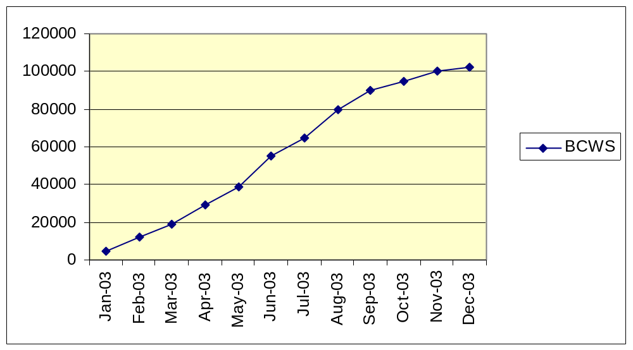
BCWS - Budgeted Cost of Work Scheduled
Notes:
Sort of looks like the “planned” line doesn’t it?
At this point, that’s all it is. We’re looking at how we expect to perform for the year.

Slide 27
Earned Value Definitions (cont.)
ACWP: “Actual Cost of Work Performed”
  Cost incurred to accomplish the work that has been done to date.
Notes:
This is simply the actual cost to date.

Slide 28
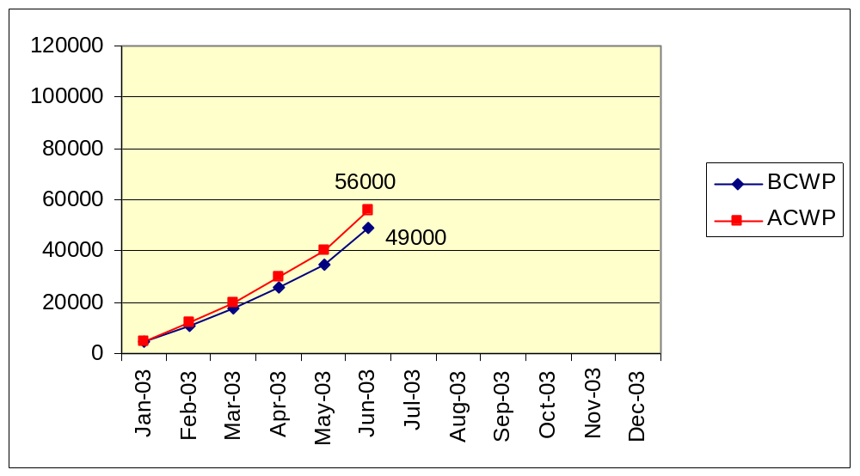
ACWP - Actual Cost of Work Performed
Notes:
And here’s that dreaded actual vs. planned situation.
Well the project is “somewhat” over cost.
“Somewhat” could have a lot of different meanings.
So far we’ve spent 56K when we should have spent 49K.
OK, we’re 7K over budget, is that bad? Well, let’s find out how bad.

Slide 29
Earned Value Definitions (cont.)
BCWP: Budgeted Cost of Work Performed
  The planned (not actual) cost to complete the work that has been done.
Notes:
The next factor is BCWP and this is the factor that rounds out EVA and makes it possible to capture the full picture of where the project stands.
Note that this is the cost of the work performed and,it is the budgeted amount, not the actual amount.

Slide 30
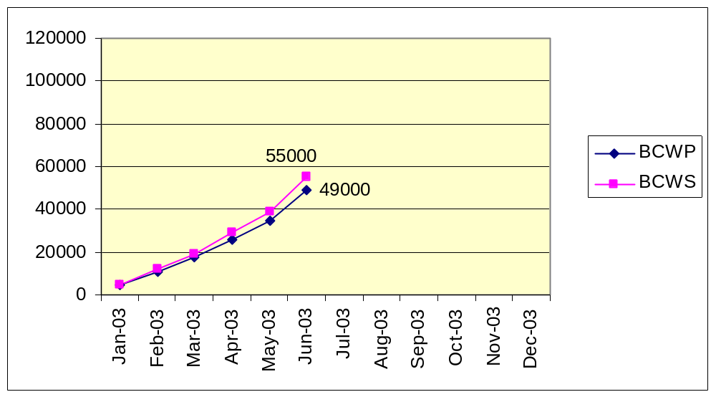
BCWP - Budgeted Cost of Work Performed
Notes:
SO, we’re about half-way through the year now, and you can see that the Budgeted cost of Work Performed is less than the Budgeted Cost of Work Scheduled.
What does this mean?
It doesn’t mean that we’ve spent less than we planned.
Your looking at the cost of what should have been done. The project is behind schedule.
The significance of this situation becomes a lot clearer when you combine cost performance with schedule performance on one chart.

Slide 31
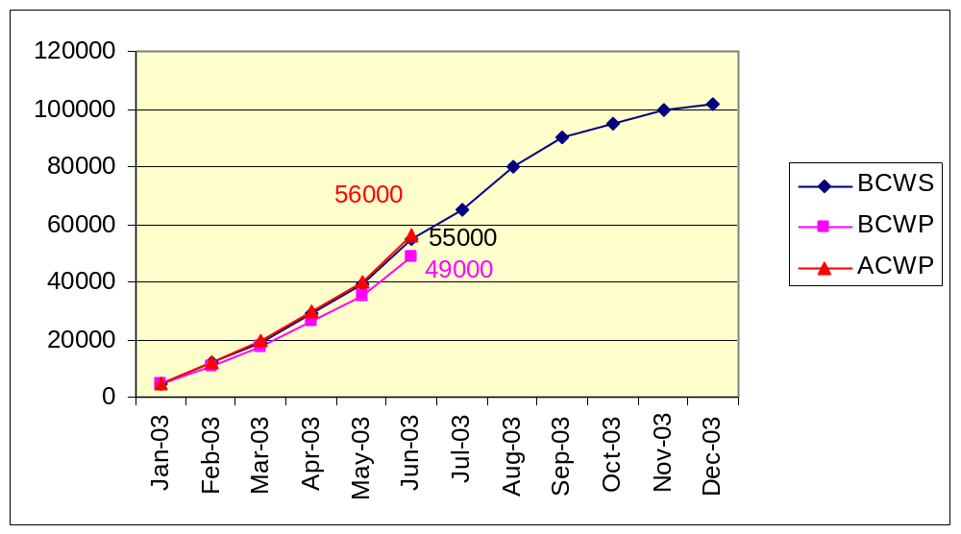
The Whole Story
Notes:
And here’s the full picture.
The project is over budget by a thousand dollars.
We’ve only gotten 49 thousand dollars worth of work down. And what does that mean? - - - (we’re behind schedule.)
So what does all this mean?
Well, pay particular attention to the comparison of ACWP compared to BCWP.

Slide 32
Some Derived Metrics
SV: Schedule Variance (BCWP-BCWS)
  A comparison of amount of work performed during a given period of time to what was scheduled to be performed.
  A negative variance means the project is behind schedule
CV: Cost Variance (BCWP-ACWP)
  A comparison of the budgeted cost of work performed with actual cost.
  A negative variance means the project is over budget.
Notes:
Oh Boy! Some derived metrics – you were all waiting for some of those, weren’t you?
Cost Variance and Schedule Variance are simply arithmetic differences of where we are and where we should be.

Slide 33
Schedule Variance & Cost Variance
Schedule Variance = BCWP-BCWS
$49,000
- 55,000
SV = - $ 6,000
Cost Variance = BCWP-ACWP
$49,000
56,000
CV = - $7,000
Notes:
Simple arithmetic.
We’ve accomplished $6,000 worth of output less than we should have
And we’re $7,000 over budget
We need some more derived metrics.

Slide 34
Some More Derived Metrics
SPI: Schedule Performance Index SPI=BCWP/BCWS SPI<1 means project is behind schedule
CPI: Cost Performance Index CPI= BCWP/ACWP CPI<1 means project is over budget
CSI: Cost Schedule Index (CSI=CPI x SPI)
  The further CSI is from 1.0, the less likely project recovery becomes.
Notes:
Well, we know we’re behind schedule and over cost,
and we know exactly much for each one, but so what?
Well, now we can begin to integrate these two pieces of information and get an overall picture.
The Performance Indices are really just a way of calculating, on a percentage basis, where we are.
SPI
CPI
But now, when we combine the two, the percentage figure becomes more significant.

Slide 35

Performance Metrics
SPI: BCWP/BCWS
49,000/55,000 = 0.891
CPI: BCWP/ACWP
49,000/56000 = 0.875
CSI: SPI x CPI
.891 x .875 = 0.780
Notes:
Too many numbers!
OK, we’re performing at about 89% of where we should be on performance,
our cost performance is a little worse,
But look at the impact when you combine the two!
What do we do now?

Slide 36

Making Projections
Once a project is 10% complete, the
overrun at completion will not be less
than the current overrun.
Once a project is 20% complete,
the CPI does not vary from its current
value by more
than 10%.
The CPI and SPI are statistically accurate indicators of final cost results.
Source: Defense Acquisition University
Notes:
Unlike the stock market, in the program management world,
Past Performance is an indicator of future results.
Let’s take a look at what this would mean for our sample project.

Slide 37
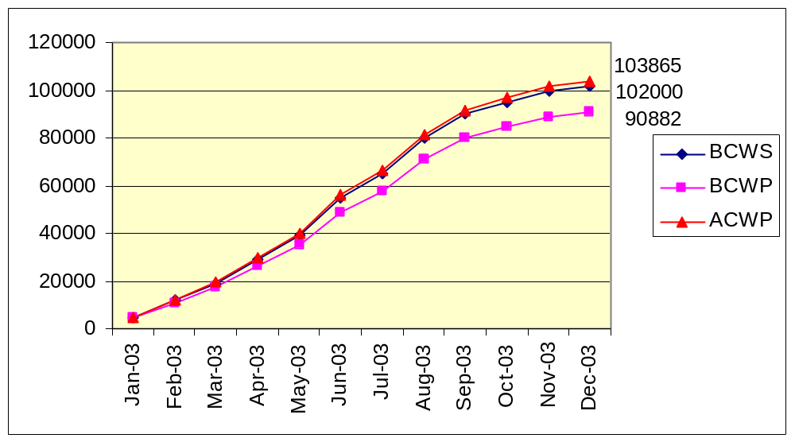
Making Projections
Today
Notes:
We can expect to finish the year having spent a bit more than was budgeted.
But look at the ACWP curve: We have only delivered 89% of the product
but we’ve spent everything we had, plus more.
Final line? Without a change in performance, we would have to spend an additional 28% of our budget to complete the job.
Why 28% when we’re only 11% behind? Because our Cost/Schedule Index says we will only be able to perform to a 78% level, and we’ll continue to fall behind.

Slide 38
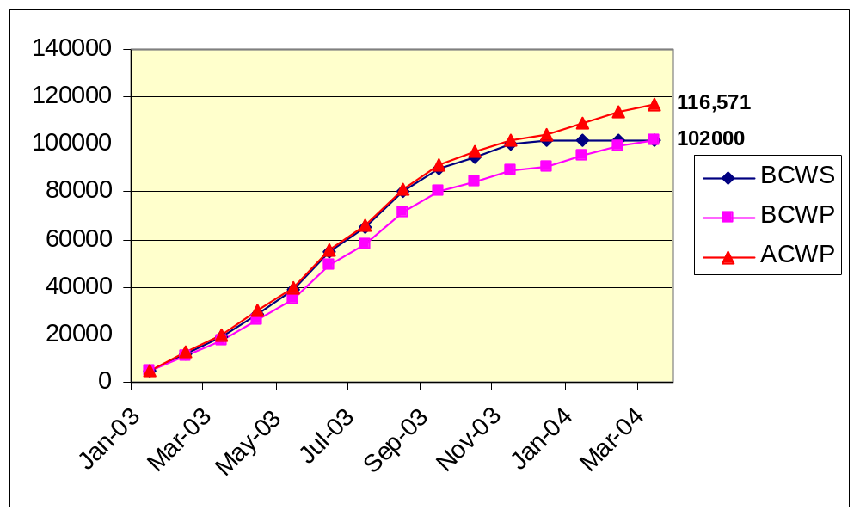
Estimate to Complete
Today

Slide 39
A New Criteria
Activities “earn value” as they are completed.
  The value earned is the WBS budgeted cost of the activity completed to date.

Slide 40

Value of Earned Value
Schedule Status Reporting
Cost Status Reporting
Forecasting

Slide 41

But How Do I Do All This Stuff ?
With an Earned Value Management System

Slide 42
A-11, Part 7 Requires an EVMS
“ . . . based on ANSI/EIA Standard 748”
And what does that mean?
ANSI/EIA 748 provides a list of guidelines
  Organization
  Planning, Scheduling, and Budgeting
  Accounting Considerations
  Analysis and Management Reports
  Revisions and Data Maintenance
But, ANSI/EIA 748 doesn’t identify ‘approved systems’

Slide 43

A-11, Part 7 Requires an EVMS
So where do I get one?
Buy a prepackaged one. (Lot of ‘em around)
Make your own.
  Microsoft Project
  Microsoft Excel
Or it could be as simple as this:
Notes:
Prepackaged EVMS may not fit in terms of
level of WBS
task description (SOW)
flexibility for a variety of projects
Microsoft Project 2002 purported to support EVA
Calculations are simple in and of themselves.

Slide 44
Requirements of Earned Value
Proper WBS Design
Baseline Budget Control Accounts
Baseline Schedule
Work measurement by Control Account
  work-hours, dollars, units, etc.
Good Project Management Practices
Notes:
You need the WBS structure to be able to quantify output (what is the deliverable?)
Baselines provide a measuring stick.
And if there are not good management practices in place, it won’t work.

Slide 45
Shortcomings of Earned Value
Quantifying/measuring work progress can be difficult.
Time required for data measurement, input, and manipulation can be considerable.

Slide 46
Summary
EVA & EVMS will help reduce guesswork in:
  Measuring performance
  forecasting
Need to get beyond misleading measures of progress.
Reasons to use EVA and EVMS:
  Good project management practice
  OMB requirement
Incorporate into contracts
Notes:
OMB requirements are going to be strongly focused on Project Management and Performance Measurement
But Earned Value makes sense without OMB’s motivation
OMB’s requirement applies specifically to contractors.

Slide 47
Earned Value Resources
http://www.pmi.org/
http://www.acq.osd.mil/pm/
ANSI/EIA 748 is available from:
Global Engineering Documents
800-854-7179

Slide 48
Some “Compliant” Systems
Welcom “Cobra” http://www.welcom.com/
Schedulemaker http://www.schedulemaker.com/
Planisware “OPX2” http://www.planisware.com/
RiskTrak http://www.risktrak.com/index.htm
Winsight http://www.cs-solutions.com
Primavera Systems http://www.primavera.com

Slide 49

Earned Value Analysis
Questions/Discussion

